Slide 1


SUTD IEEE Arduino workshop

Slide 2
Overview of workshop
Electronics
Troubleshooting
Programming

Slide 3
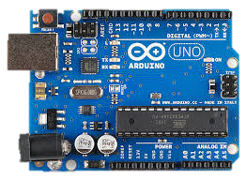

What is an Arduino?
Microcontroller – Programmable Circuit Board
Runs on C/C++
Small and Cheap
$1500 +++
<$10
Take away Screen and keyboard
Slower and smaller

Slide 4

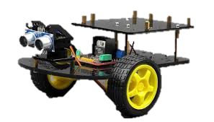
Why is it useful?
OR

Slide 5
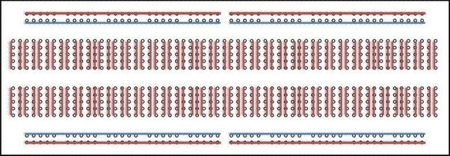
Electronics
1) Breadboard

Slide 6
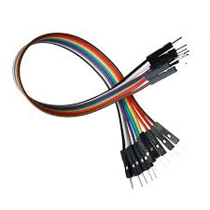
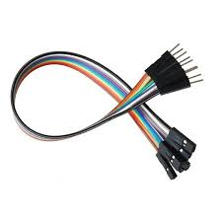
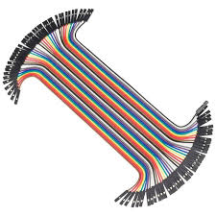
Electronics
2) Jumper Wires
Male-Male Wire
Male-Female Wire
Female-Female Wire

Slide 7
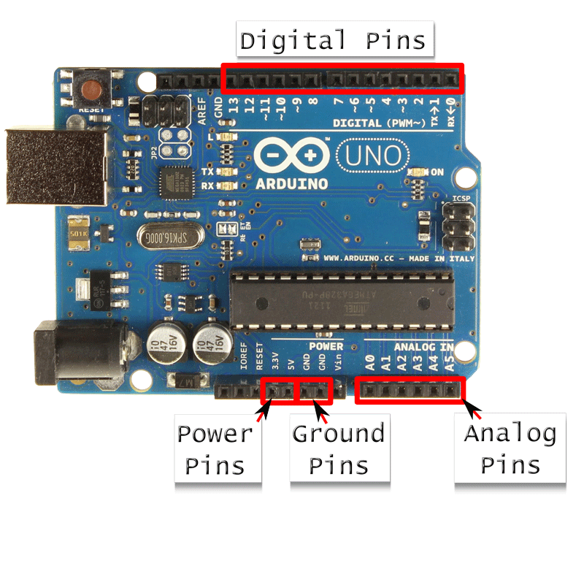
Electronics
“~” Sign refer to PWM

Slide 8
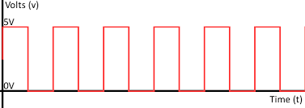
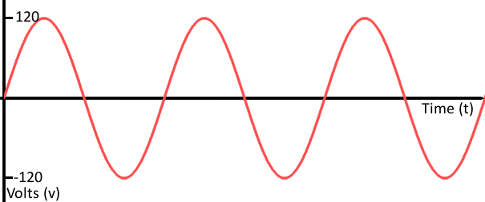
Electronics
Digital VS Analog
Digital
Analog
1 or 0
Non-continuous
Max to Minimum
Continuous

Slide 9
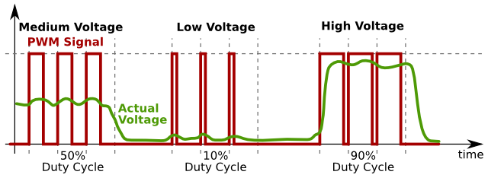
Electronics
Pulse-Width Modulation (PWM)
5V
2.5V
0V
Trick the system through frequency

Slide 10
Electronics
HIGH or LOW
1 or 0
“~” Sign refer to PWM
0 to 255
0 to 255

Slide 11
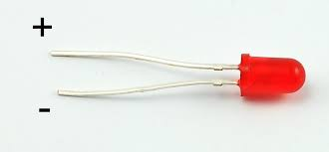
Component: LED

Slide 12
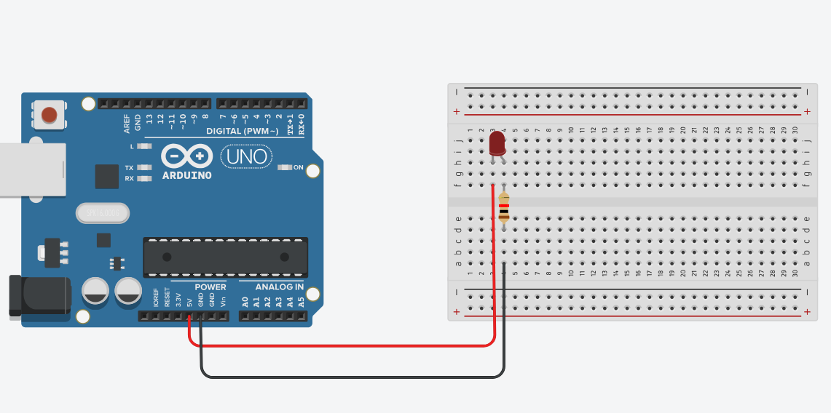
Try it out!

Slide 13
Quick physics
Power source
Load
Ground

Slide 14
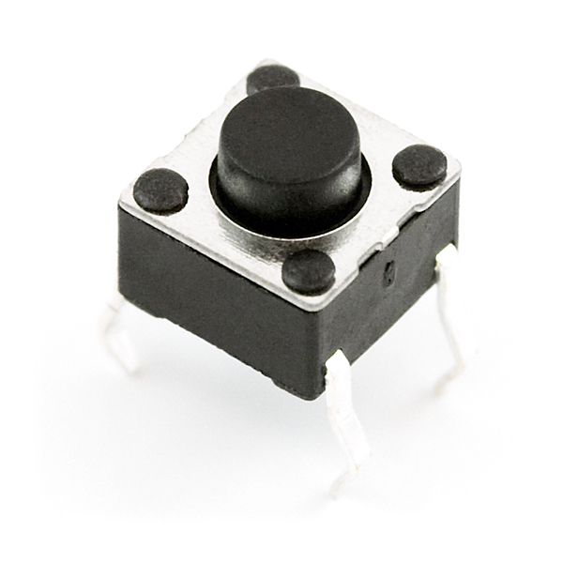
Component: Button
End 2
End 3
End 1
End 4

Slide 15
Try it out!
Create a circuit that switches on the LED when u push the button down
End 2
End 3
End 1
End 4

Slide 16
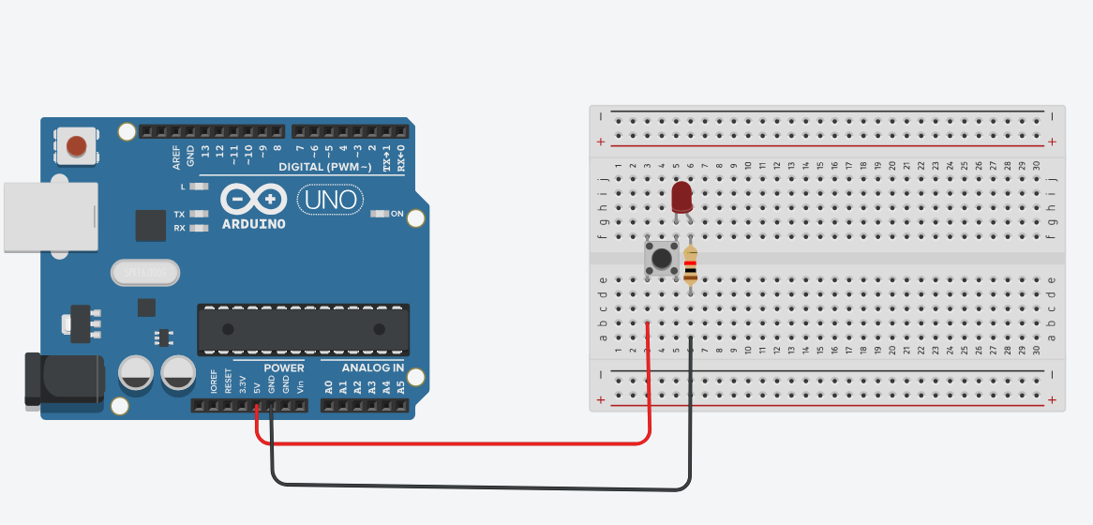
Try it out!

Slide 17
Troubleshooting
Cause using software is more about troubleshooting than writing codes ☹

Slide 18
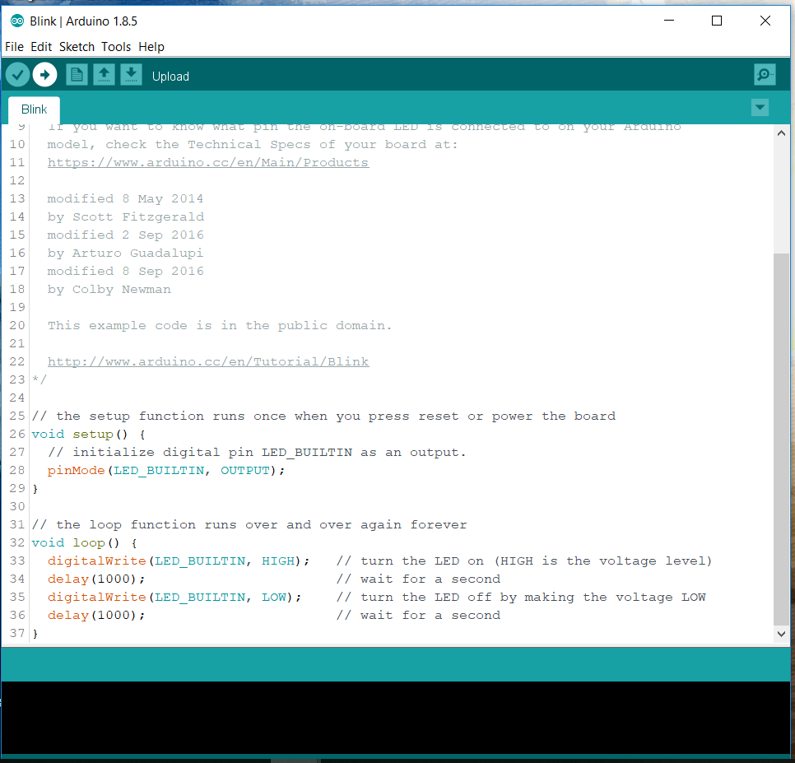
Troubleshooting
Code
Console

Slide 19
Troubleshooting
Verify
Upload
To upload code:
Check Port
Check Board

Slide 20
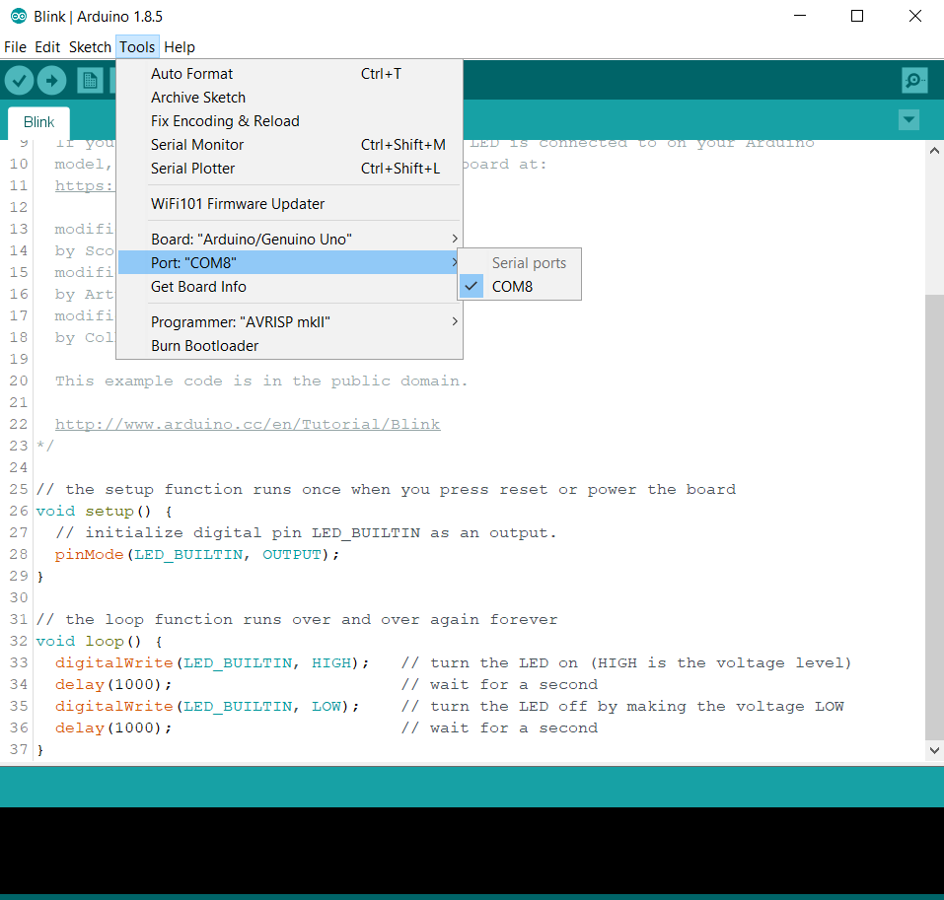
Troubleshooting
Select the port that access Arduino!
If there are multiple ports:
Unplug Arduino, check port
Plug in Arduino, pick the new port
If there is no Arduino Port, could be a driver issue. Try CH340 Driver

Slide 21
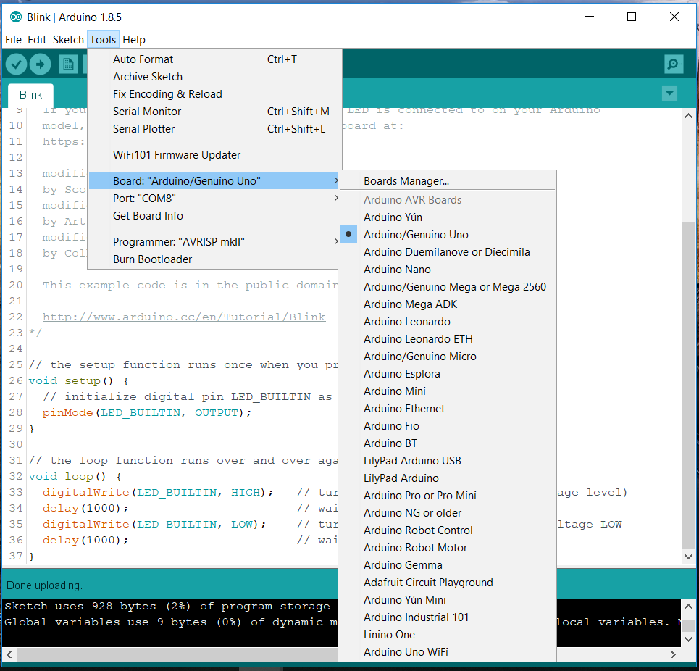
Troubleshooting
Check your board
We are using Arduino Uno

Slide 22
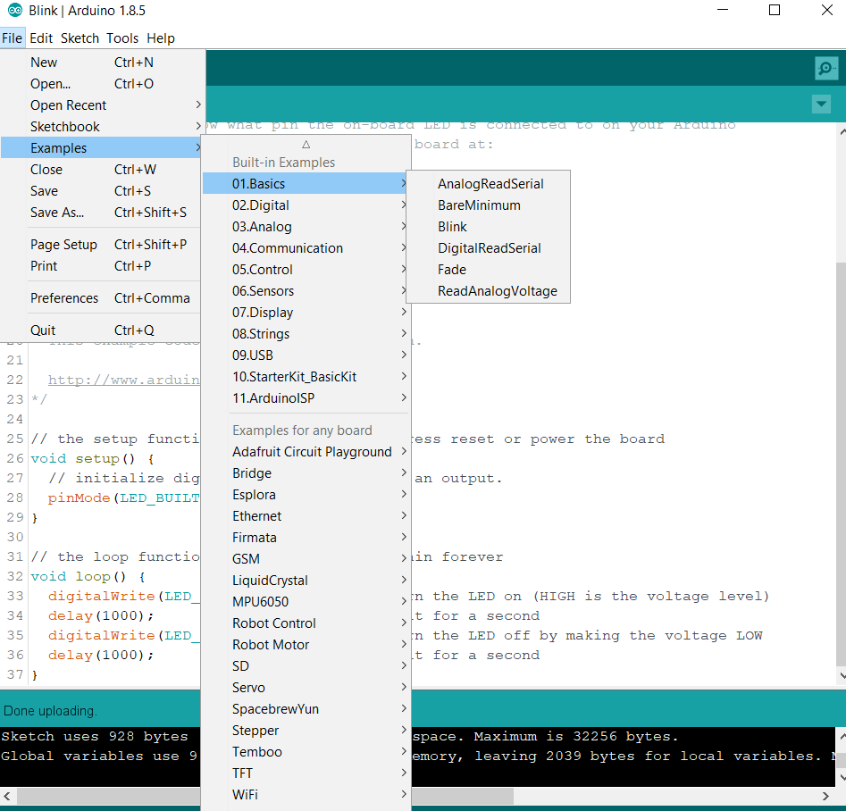
troubleshooting
There are many written code under examples!

Slide 23
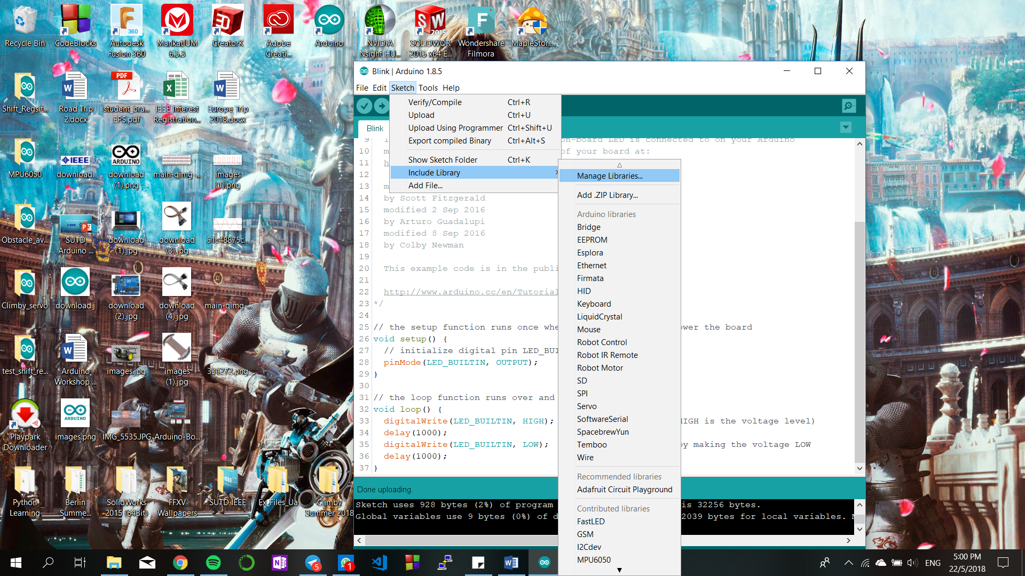
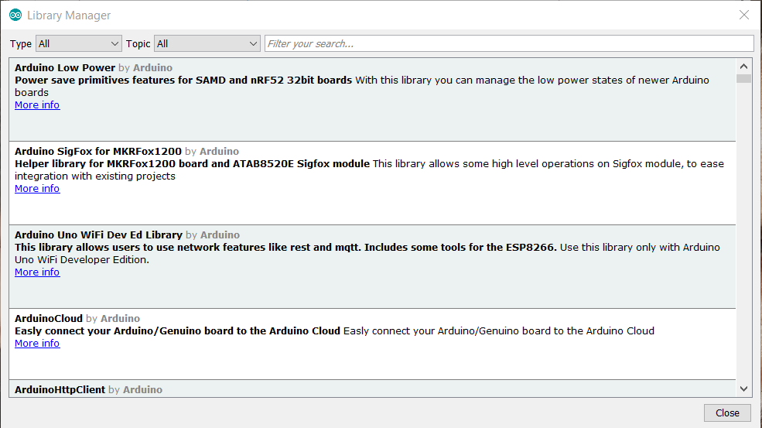
troubleshooting
Codes that make your life easier!

Slide 24
Programming
Remember the LED schematic you built? What if you want to switch it on for 1 second and switch it off for 1 second for eternity?
This is where programming comes in, the magic!

Slide 25
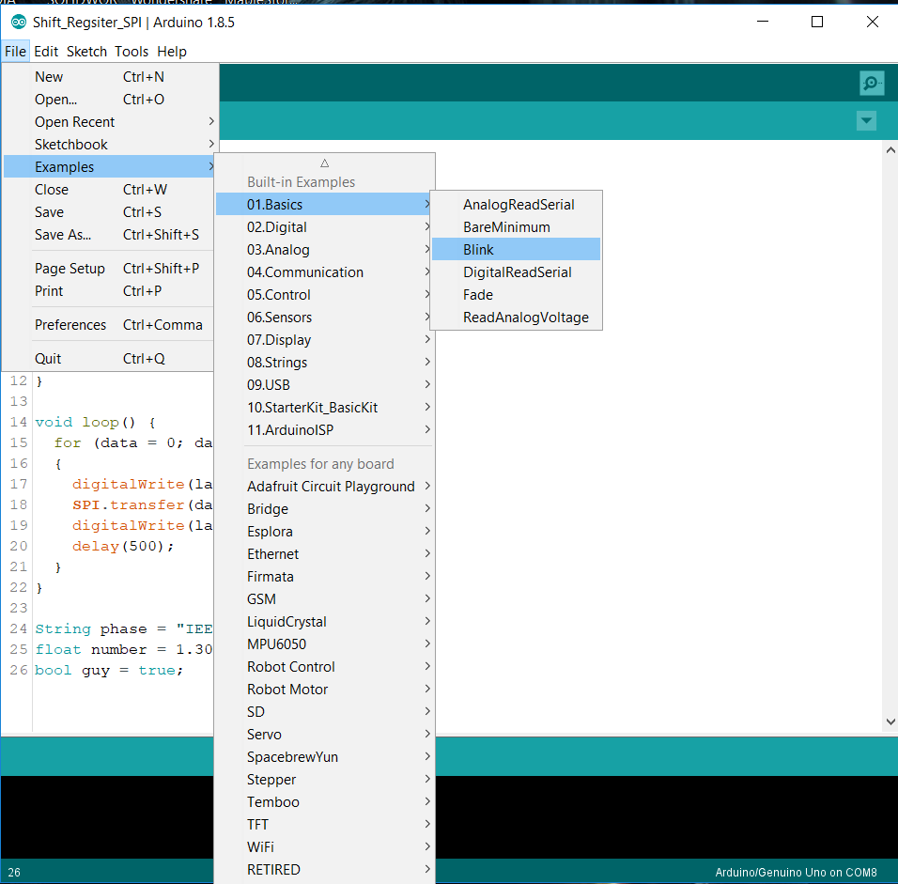
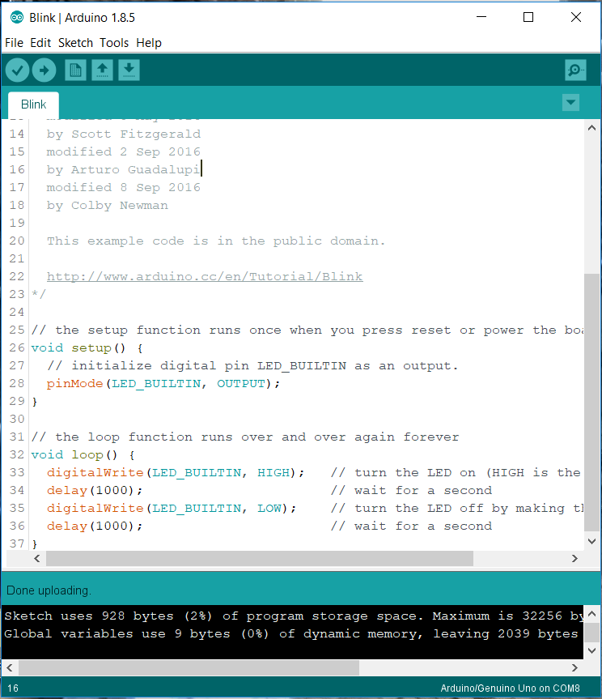
Try this!
Upload!

Slide 26
programming
C/C++ Programming
Programming is a way for you to talk to the computer!
Types of variable
Initialising variable
Syntax

Slide 27
programming
Variable types
Integers (int) : 1, 2, 5, 10
Floats (float) : 1.03, 3.00 , 7.10
Strings (string) : “Hello world”
Boolean (bool) : True , False

Slide 28
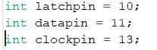
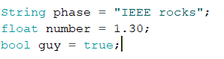
programming
Initializing Variables
(type of variable) (name of variable) = (assignment);

Slide 29
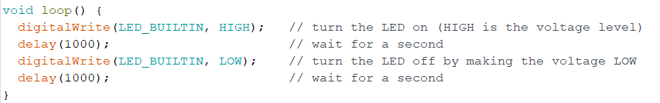
programming
Syntax (Grammar)
Syntax | Meaning (analogy)
; | Full-stop behind every sentence
{ } | Denotes a paragraph
// | Comments

Slide 30
programming
Arduino specific
void setup()
void loop()
delay()
pinMode()
Serial.begin() and Serial.println()
digitalRead() and digitalWrite()
analogRead() and analogWrite()

Slide 31
programming
void setup () {
….
….
}
It runs the code once upon start-up
void loop () {
….
….
}
It runs the code continuously after setup.

Slide 32
programming
Logic behind programming
Start-up
(plug in 5v/ upload code
Run void loop()
Run void setup()

Slide 33
programming
Delay ()
Stops all processes for a certain milliseconds!
e.g.
delay(500); //stops for 0.5 seconds or 500 milliseconds
delay(10); //stops for 0.01 seconds or 10 milliseconds
delay(1000); //stops for 1 second or 1000 milliseconds

Slide 34
programming
Serial.begin()
Initialises Serial protocol, a method to talk to your computer! It comes with baud rate (bit rate).
e.g.
Serial.begin(9600);
Serial.begin(115200);

Slide 35
programming
Serial.println()
Uses Serial protocol to send characters to your computer
e.g.
Serial.println(“Hello world);
Serial.println(35);

Slide 36
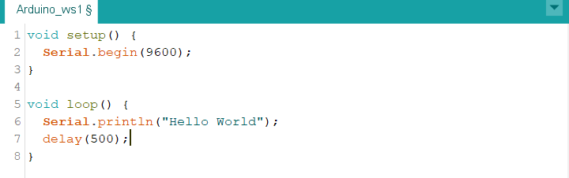
Try this! Hello world example!
Logic:
Runs void setup()
Initialise serial protocol at 9600 baud rate
2) Runs void loop()
Use serial protocol to print “hello world”
Waits for 0.5 seconds
Once done writing
Click upload
Press Ctr-Shift-M

Slide 37
programming
PinMode()
Tells the Arduino which pin you are using, if it is OUTPUT or INPUT!
e.g.
pinMode(3, OUTPUT)
pinMode(A0, INPUT)

Slide 38
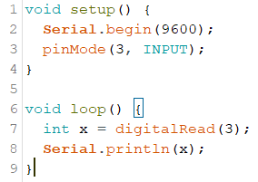
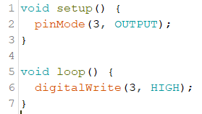
programming
digitalWrite() and digitalRead()
DigitalWrite()
Output
HIGH or LOW
DigitalRead()
Output
Returns 1 or 0

Slide 39
Try this!
Make your LED blink for 1 second every 1 second!
Feel free to change the blink example code!

Slide 40
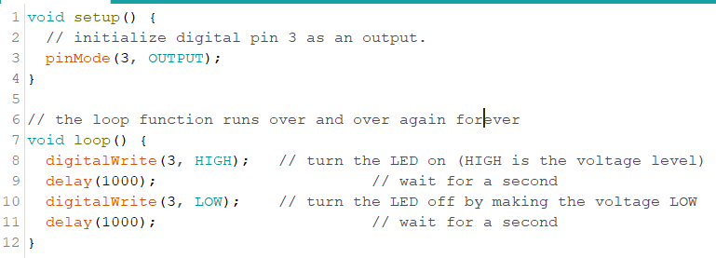
programming

Slide 41
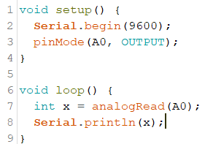
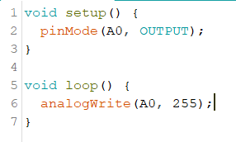
programming
analogWrite() and analogRead()
analogWrite()
Output
0 to 255 ()
- 255 refers to 5v
analogRead()
Output
Returns 0 to 1023
1023 refers to 5v

Slide 42
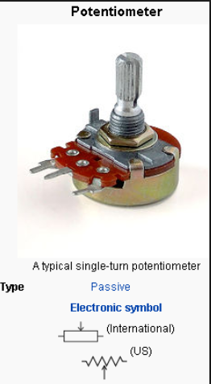
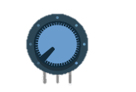
Component: potentiometer
Physics quick course:
Changes the resistance when the knob is turned! When it’s resistance is turned, the voltage output also changes!
5v
Gnd
analogpin

Slide 43
Try this!
Change a LED brightness when the knob of the potentiometer turns! Scales accordingly!
To – Do:
Attach potentiometer to 5v, Gnd and an analogpin
Attach LED to a PWM pin and Gnd
pinMode to set OUTPUT and INPUT
Read voltage from analogpin
Output it to PWM pin

Slide 44
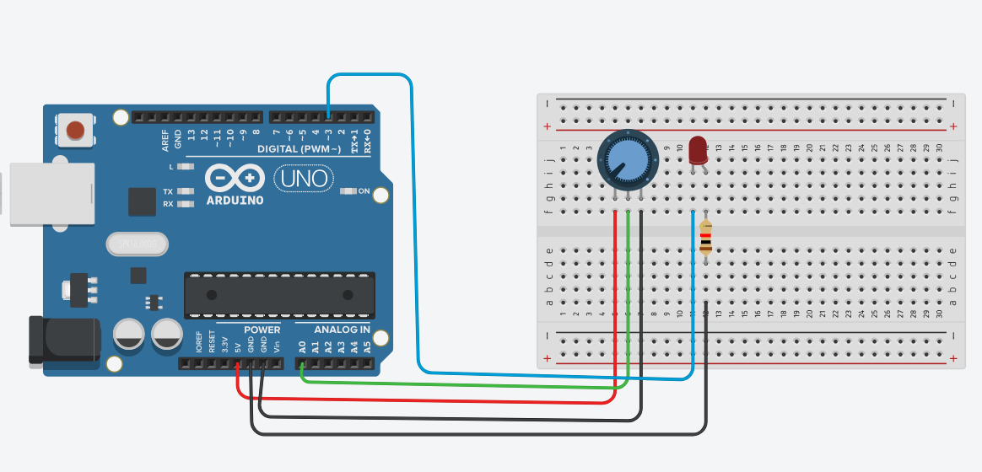
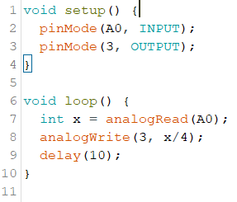
Try this!

Slide 45
Omg, why pwm and not analog?
LED works on threshold voltage, it needs a minimum of 2 volts to light up.
5V
2.5V
0V

Slide 46
programming
If , else if and else statements
If : Check if a condition is true. If it is true, executes the following code and break
Else if : Checks the next condition when the previous statement fails. If it is true, execute the following code and break
Else : When all other statements fail, execute the following code and break

Slide 47
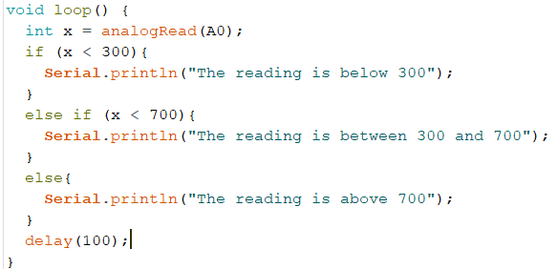
programming
Your potentiometer reads from 0 to 1023.
This is essentially checking what your potentiometer have and printing the corresponding message.

Slide 48
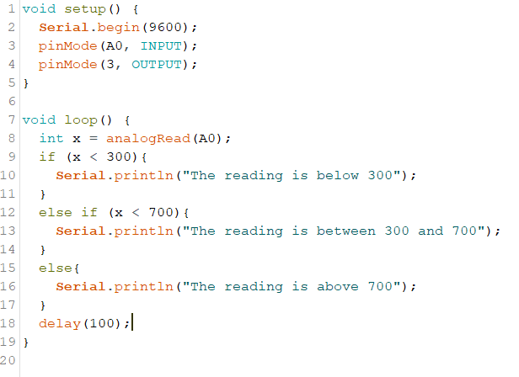
Try this out!

Slide 49
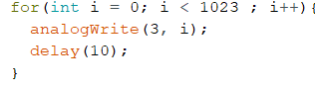
programming
FOR loop
Essentially a loop that breaks when it hits a criteria! It follows the convention below!
Initialise counter variable ; set variable criteria, change counter

Slide 50
Try this!
Using For loop, make the LED brightness increase to maximum then decrease. Repeat it forever!
To-Do:
Set pinMode
For FOR loop to give the value to the LED

Slide 51
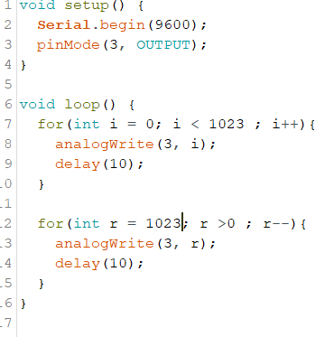
Try this!

Slide 52
programming
Operators
Symbols | Meaning
< | Less than
> | More than
== | Equivalent to
!= | Not equivalent to
++ | Increment by 1
-- | Decrease by 1

Slide 53
summary
Electronics

Slide 54
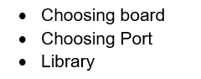
summary
Troubleshooting

Slide 55
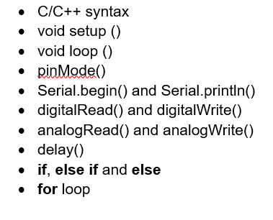
summary
Programming

Slide 56
summary
Components

Slide 57
the end
Hope you guys enjoy and learnt something today!
Please keep all the kits and return to us!
We are doing Arduino games next session!
https://tinyurl.com/IEEEarduinoWS
Supper anyone?

